Slide 1
19ECE204 Digital Electronics and Systems III Semester B. Tech. (ECE & CSE) Amrita School of Engineering, Bengaluru Lecture 45 to 46

Slide 2
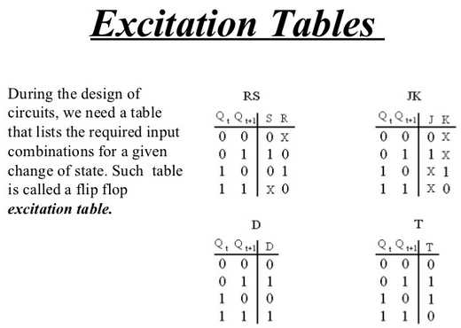
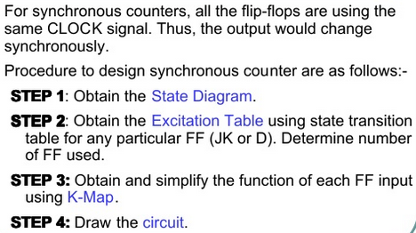
Steps to Design a Synchronous Counter

Slide 3
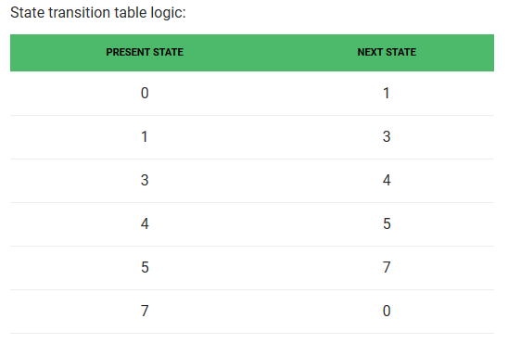
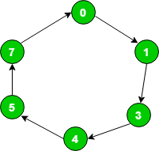
Design synchronous counter for sequence: 0 → 1 → 3 → 4 → 5 → 7 → 0, using T flip-flop.
For given sequence, state transition diagram as following below

Slide 4
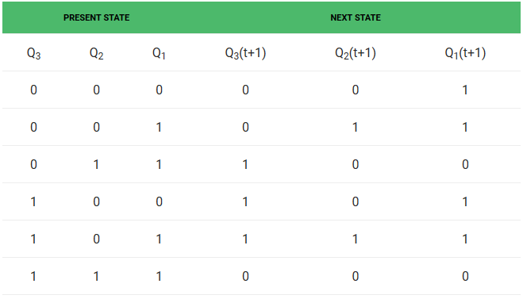
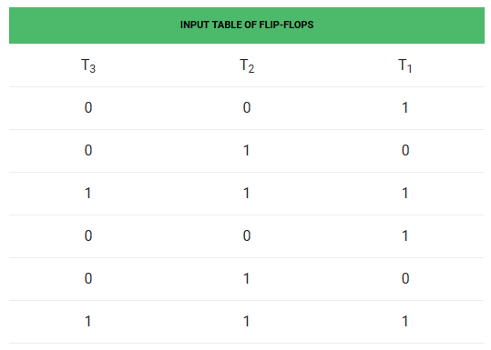
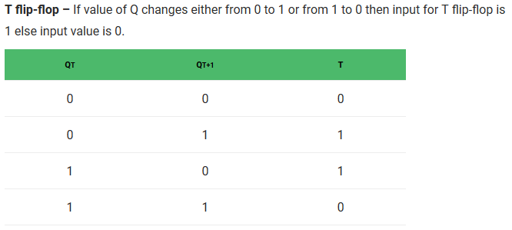
Compare Qn with Qn(t+1) and use excitation table of the flipflop to be used and write the excitation table for the counter to be designed

Slide 5
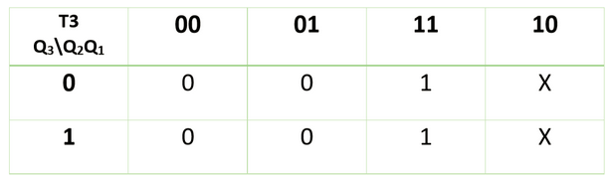
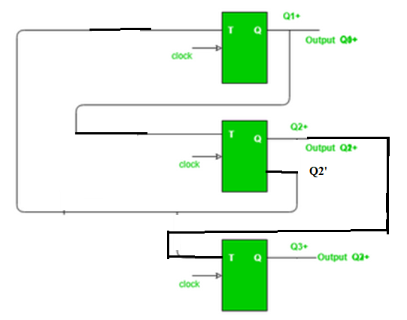
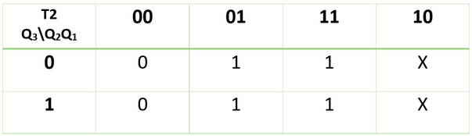
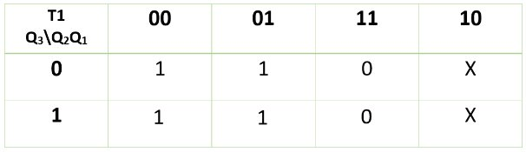
Find value of T₃, T₂, T₁ in terms of Q₃, Q₂, Q₁ using K-Map (Karnaugh Map):
Therefore,
T₃ = Q₂
Therefore,
T₂ = Q₁
Therefore,
T₁ = Q₂’

Slide 6
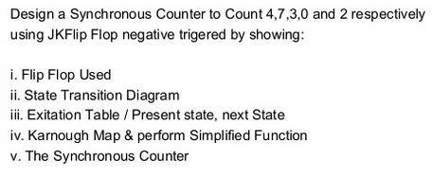

Slide 7
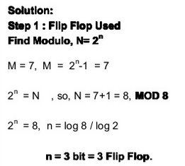
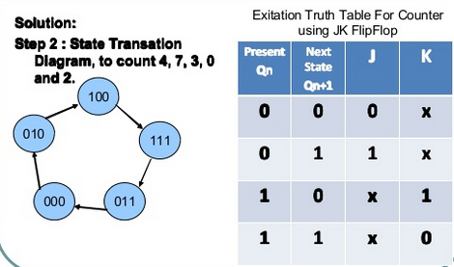

Slide 8
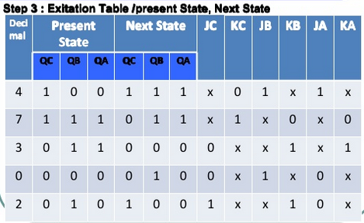
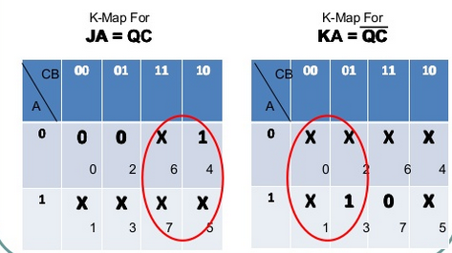

Slide 9
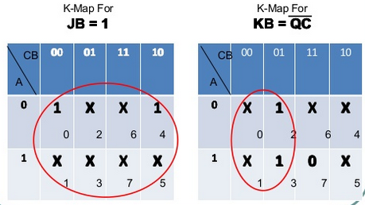
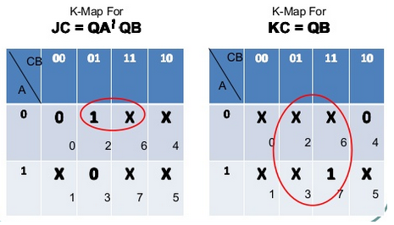

Slide 10
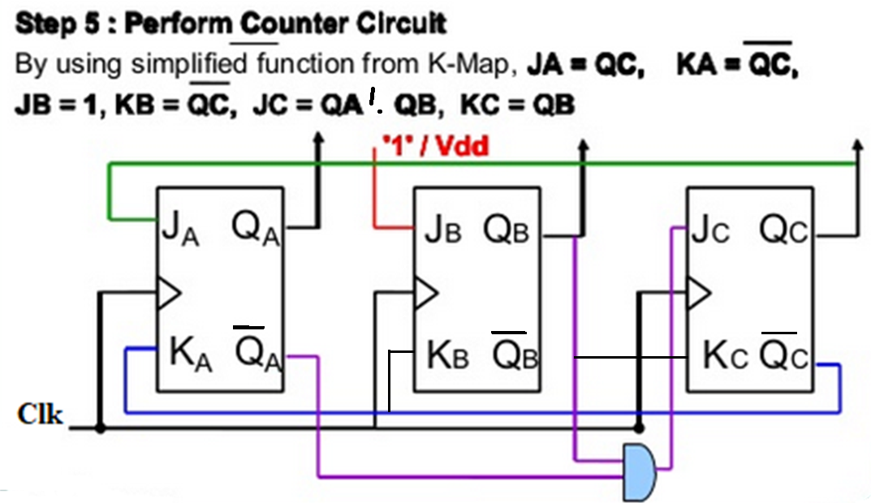

Slide 11
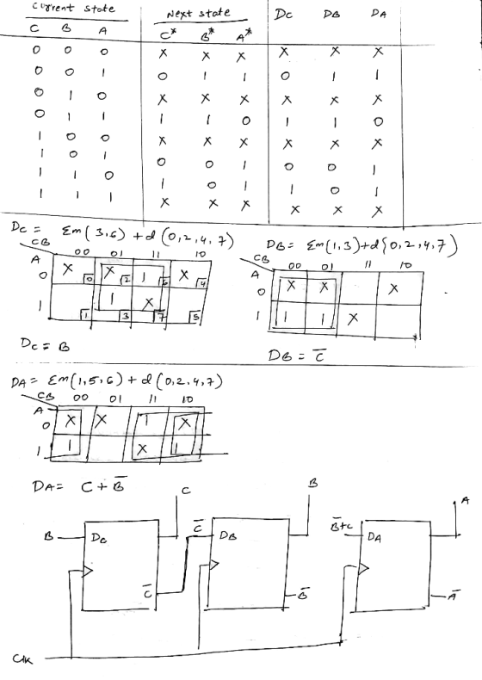
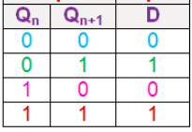
This counter counts 1, 3, 6, 5, 1 using D flip flop.
To get the minimized cost the unused state can be assumed to go to don’t care state

Slide 12
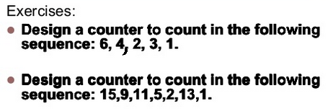
Use D flip-flop

Slide 13
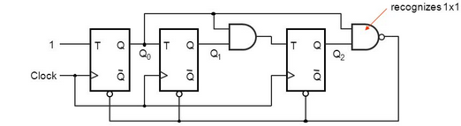
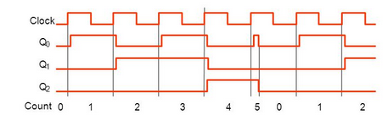
Identify the output of the circuit – if the clear signal is assumed to be asynchronous signal

Slide 14
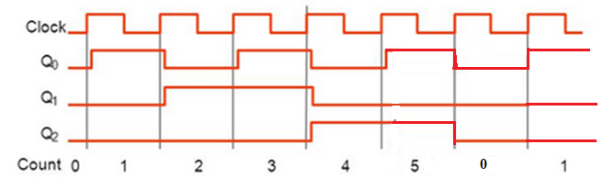
Identify the output of the circuit – if the clear signal is assumed to be synchronous signal

Slide 15
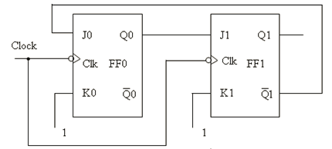
Home Work - Identify the output of the following Circuit
Clock | Q1 | Q0
 | 0 | 0
1st | 0 | 1
2nd | 1 | 0
3rd | 0 | 0
4th | 0 | 1
Assume initial value on Q1 Q0 = 00

